Slide 1
Automated Cellular Classification
Michael Morehead

Slide 2
Outline
Goal of Project
Problem
Representations
Two common methods:
Signature models
Graph-based models
Combination

Slide 3
The Problem
Given a set of neuron models, is it possible to automatically predict the cell type, age, function, etc.
Neuron models could be:
EM resolution models stored as OBJs
Light microscopy “ball-and-stick” models stored as SWC

Slide 4
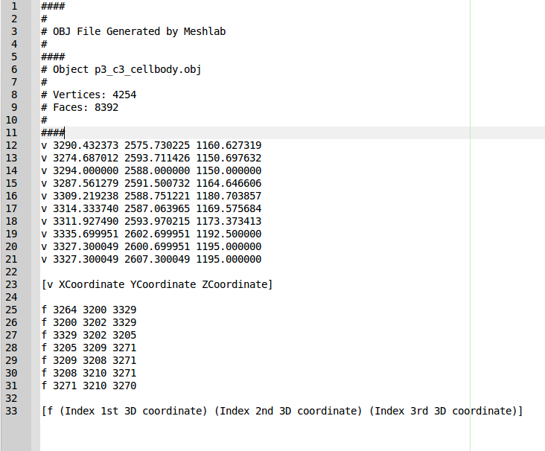
OBJ format

Slide 5
SWC Format
# Original file ca3b-N2.swc edited using StdSwc version 1.31 on 10/10/11.
# Irregularities and fixes documented in ca3b-N2.swc.std. See StdSwc1.31.doc for more information.
#
# NEUROMANTIC V1.6.3 (10/10/2011 1:34:13 PM): Saved to ca3b-N2-T1.swc
1 1 436.0 -1566.0 533.2 1.5 -1
2 3 435.1 -1583.0 500.0 1.5 1
3 3 438.2 -1586.0 500.0 1.5 2
4 3 441.3 -1587.0 500.0 1.5 3
5 3 447.3 -1587.0 500.0 1.5 4
6 3 450.6 -1597.0 500.0 1.5 5
7 3 458.1 -1593.0 500.0 1.5 6
8 3 467.1 -1610.0 500.0 1.5 7
9 3 469.3 -1608.0 533.2 1.5 8
10 3 470.9 -1618.0 500.0 1.5 8
11 3 456.5 -1617.0 500.0 1.5 10
12 3 454.3 -1615.0 533.2 1.5 11
13 3 473.3 -1624.0 500.0 1.5 10
14 3 473.6 -1621.0 533.2 1.5 13

Slide 6
Different current methods
Signature model
Process point cloud into a feature vector
works nicely with both data types
computationally efficient
reasonably good recognition rates
Graph-based models
great representational power
greater computational cost
trouble getting OBJs into a graph

Slide 7
Novel Signature Model
Extract point cloud from OBJ
Construct Spin Images for randomly selected 1000 points
Cluster spin image histograms into “word” centroids
Produce spin images for some % of remaining points, assign each to nearest centroid
Each cell is described as a feature vector containing the count of each 'word'

Slide 8
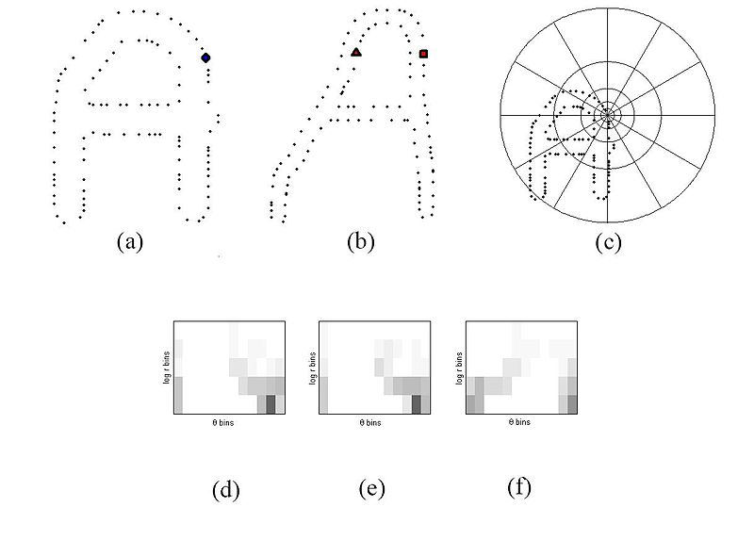
Explanation of Spin Image

Slide 9
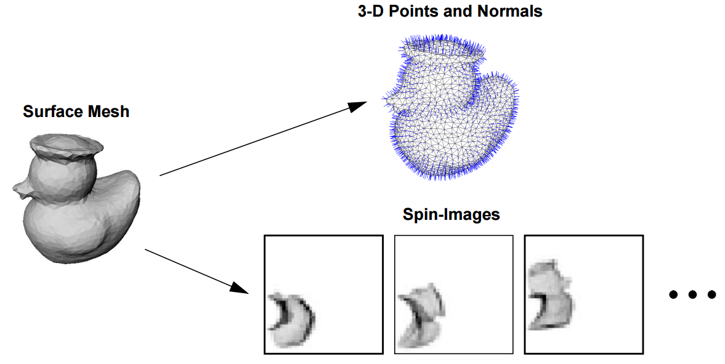
Spin Images

Slide 10
Pros and Cons
CONS
Somewhat time consuming runs (hours)
Too many parameters!
Spin images
K-means
Number points to sample
% points to map to words
SVM
Pros
Logically sound
Produces high accuracy

Slide 11
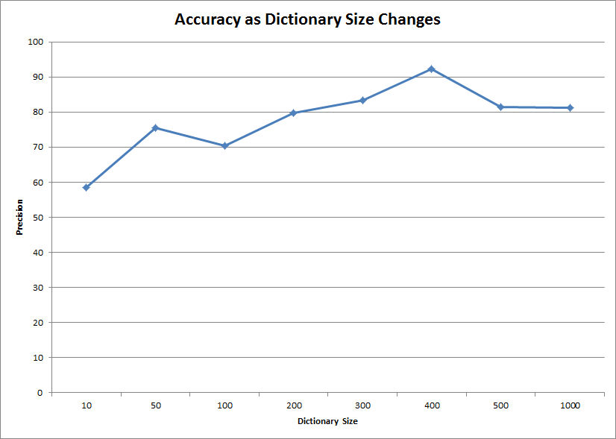
Some results

Slide 12
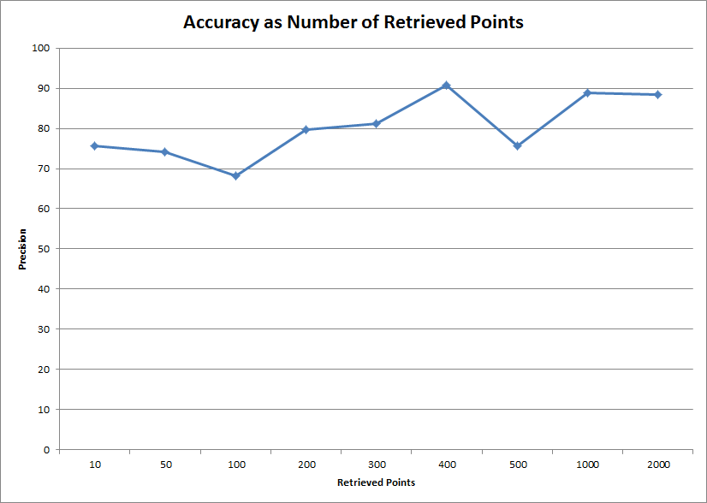
Some results

Slide 13
Graph-based method
Leverages work from geometric tree kernel paper for COPD
Represent cells as graph
Compare each cell-graph to every other cell-graph
Utilize similarity matrix for classification
SVM produced high accuracy (96% LOO)

Slide 14
Problems with Graph
O(n^2) for producing similarity matrix
Kernel code isn't fast either
Scaling to thousands of cells could require parallelization
Producing graphs from OBJ open problem
Currently producing graphs from IMOD files where each slice can be graph node
Some algorithms attempt to skeletonize cloud points but often introduce artifacts (TEASER algorithm)

Slide 15
Combination
Each node in graph can contain a feature vector
Load shape context into each node provides high representation of both graph structure and local shape descriptor
Untested...

Slide 16
Questions?

